Slide 1
EECS 370
Lab 1: Binary & C

Slide 2
Lab Logistics
Attendance is required, and you must attend your section (waived for this week)
For one-off conflict or sickness/emergency, lowest lab score is dropped automatically
Fill out admin form if you need to miss so we have a record.
If there will be an ongoing conflict, please switch sections. Check the form on our website for help.
Recordings of content without assignments are on our YouTube.
You can find these slides in our Google Drive
Notes:
Attendance only taken for students present after the first 10 mins, please consult the admin form for any other one-time conflicts.

Slide 3
Lab Logistics
All lab assignments will be done in groups.
You may choose your own groups this week
We will form groups for the rest of the semester
Fill out lab survey today!
Note: Staff reserves the right to change groups at any time

Slide 4
Grade Breakdown
20% - Asynchronous lecture quiz
Due 11:55 pm Thursday BEFORE lab
Covers lecture material from previous week
80% Group assignment
For today: done electronically, submit yourself to Gradescope by 11:55 pm Sunday evening
Later labs: done on paper, you will turn in your assignment at the end of lab (no late submissions, must be present to get credit!)

Slide 5
This Lab will cover:
Decimal, Binary, and Hexadecimal (Hex)
Differences between C and C++
Visual Debugger Setup Tutorial

Slide 6
What’s going in inside computers?
Computers are primarily made up of wires and logic gates.
Follow the instructions in the lab assignment to read more on gates.
Voltages in the wires correspond to logical values.
High Voltage = True = 1
Low Voltage = False = 0
If we only have 2 values per wire, we need new representations of numbers and other data…

Slide 7
Basics of Decimal, Binary, and Hexadecimal
Decimal: a number system based on the number ten (decim = Latin for ten)
This is the “regular” number system people use. Base is ten since we have ten fingers
Binary: a number system based on the number two (bis = Latin for twice)
This is what computers use. Base is two so we can represent everything with “on” and “off” or “true” and “false”
Hexadecimal (Hex): a number system based on the number sixteen (hex = Greek for six, so hexadecim = sixteen)
The base of each number system will determine place values and digits.

Slide 8
Decimal, Binary, and Hexadecimal (Hex)
 | Each digit represents a power of: | Each digit can take the values: | Example: 94₁₀ | Declare the value in C/C++
Decimal | 10 | 0-9 (digit) | 94₁₀ | x = 94
Binary | 2 | 0, 1 (bit) | 1011110₂ | x = 0b1011110
Hex | 16 | 0-9, A-F (hexdigit) | 5E₁₆ | x = 0x5E

Slide 9
Expanded Form
Sometimes we might write a number in expanded form to determine place values:
Example: 913 = 9 * 100 + 1 * 10 + 3 * 1
= 9 * 10² + 1 * 10¹ + 3 * 10⁰
In this example, 9 would be called digit 2 since we multiply by 10²
The next slide breaks down expanded form for binary and hexadecimal.

Slide 10
Expanded form for Binary and Hexadecimal
 | Decimal | Binary | Hex
Digits | 9 4 | 1 0 1 1 1 1 0 | 5 E
Values | 10¹ 10⁰ | 2⁶ 2⁵ 2⁴ 2³ 2² 2¹ 2⁰ | 16¹ 16⁰
Conversion Back to Decimal | 9*10¹ + 4*10⁰ = 94 | 2⁶ + 2⁴ + 2³ + 2² + 2¹ = 94 | 5*16¹ + 14*16⁰ = 94

Slide 11
Quick Pause
On the next slide, we will introduce the first problem for our weekly assignment. We’ll do this problem together as an example.
We will upload a Google Doc with some work.
Sometimes, like today, it will include autograder coding assignments.
For now, open Lab 1 Assignment from the Google Drive.

Slide 12
Problem 1: Conversion from Binary
Convert the following Binary into Decimal and Hex and submit:
0101 1010 1101
Decimal: Sum each of the representations
0 + 2¹⁰ + 0 + 2⁸ + 2⁷ + 0 + 2⁵ + 0 + 2³ + 2² + 0 + 2⁰ = 1453
Hex: Sum representations OR Group bits into “nibbles” of 4 and convert
0101 -> 5, 1010 -> A, 1101 -> D = 0x5AD
Octal (for fun): Can you figure out how to convert into base 8?

Slide 13
Basic Operations in Binary
Since bits represent T/F values, we can apply truth tables bitwise:
X | Y | X & Y
0 | 0 | 0
0 | 1 | 0
1 | 0 | 0
1 | 1 | 1
X | Y | X | Y
0 | 0 | 0
0 | 1 | 1
1 | 0 | 1
1 | 1 | 1

Slide 14
Addition in Decimal and Binary
Binary addition is the same as decimal addition, just with 2 digits.
105 01101001
+ 99 + 01100011
204 11001100
Multiplication is the same too actually, but we’ll come back to that later.
1 1
1 1 1 1

Slide 15
This Lab will cover:
Decimal, Binary, and Hexadecimal (Hex)
Differences between C and C++
Visual Debugger Setup Tutorial

Slide 16
C and C++ are similar, but have slight differences
All code written for this class will be in C or assembly!
You have likely used C++ in other introductory classes (ENGR 101/151, EECS 183, EECS 280, etc.)
C is similar, but a layer of overhead is removed
For more info, check out C for C++ developers (also available in course resources on the website)

Slide 17
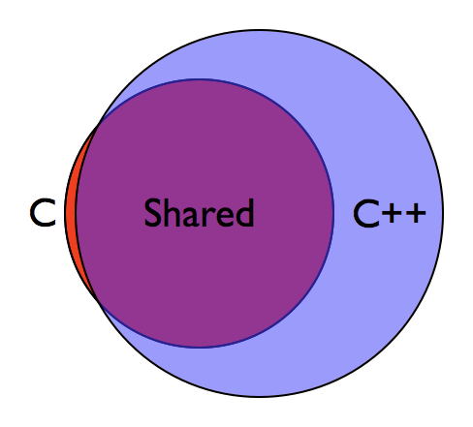
C vs C++: Important Differences
C++ | C
Classes, Objects, Structs | Only Structs (PODs)
new, delete | malloc(), free()
std::string | char*, strcmp(), strcpy()
std::vector, std::set, std::map | Only arrays
std::cout, std::cin, std::fstream | printf(), scanf(), fopen(), fgets()
Notes:
POD: Plain Old Datatype — no methods, no constructors, no destructors, no inheritance, etc.

Slide 18
The Size of Common Data Types
Data Type | Typical Size
char | 1 Byte
short | 2 Bytes
int, float | 4 Bytes
double | 8 Bytes
long (32-bit Architecture) | 4 Bytes
long (64-bit Architecture) | 8 Bytes
pointer (32-bit Architecture) | 4 Bytes
pointer (64-bit Architecture) | 8 Bytes
Notes:
sizeof()

Slide 19
More about types in C
C doesn’t have bool types (without #include <stdbool.h>)!
We have to use ints instead.
(Also watch out for int32_t - you must #include <stdint.h> to use this. But int works just fine too.)

Slide 20
Decimal, Binary, and Hexadecimal in C
These formats are just different ways of displaying the data for humans. They are stored the same way in C, so there is no need to convert between formats in C.
int main () {
int a = 15; // a = 15
int b = 0b1111; // b = 15, b == a
int c = 0xF; // c = 15, c == b
}
They are only different when printing or reading in (we took care of reading for you).
We will show later how to debug with hex.
This is useful since every nibble (4 bits) in binary corresponds to a hexdigit.

Slide 21
Bit Manipulation in C
Video Review: https://www.youtube.com/watch?v=KGPfymjE2z8&t
Despite us being able to declare variables with decimal, binary, or hex values, all data is stored as binary under the hood
In addition to performing numerical actions on the values (e.g. addition, subtraction), we can also perform actions on an integer value that directly affects its binary sequence

Slide 22
Bit Manipulation in C: Bitwise AND (&)
The Bitwise AND operator (&) performs a logical AND bitwise: between each bit of two numbers
int a = 26 // … 0001 1010
int b = 15 // … 0000 1111
a = a & b // … 0000 1010
This is extremely useful for masking bits (changing all but some useful bits to 0).
For b = 2^{n} - 1, a & b == a % 2^{n}. (P4 tip).
X | Y | X & Y
0 | 0 | 0
0 | 1 | 0
1 | 0 | 0
1 | 1 | 1

Slide 23
Bit Manipulation in C: Bitwise OR (|)
The Bitwise OR operator (|) performs a logical OR bitwise between each bit of two numbers
int a = 42 // … 0010 1010
int b = 4 // … 0000 0100
a = a | b // … 0010 1110
This is extremely useful for setting bits without changing any other values
X | Y | X | Y
0 | 0 | 0
0 | 1 | 1
1 | 0 | 1
1 | 1 | 1

Slide 24
Bit Manipulation in C: Shifting
Left Shift << and Right Shift >>
int a = 18; // … 0001 0010 int b = a >> 2; // … 0000 0100 10
int a = 18; // … 0001 0010 00 int b = a << 2; // … 0100 1000
Left shift multiplies by powers of 2, and right shift divides by powers of 2.
Note: Shifting doesn’t actually change a here. If you wanted to modify a, you’d need to reassign (a = a >> 2;)
After assignment:
b = 4. (18 / 2²)
b = 72. (18 * 2²)

Slide 25
Decimal, Binary, and Hexadecimal in C
Know the difference between the following:
Both work with C, but for different things!
Logical/Boolean Operators |  | Bitwise Operators
&& | and | &
|| | or | |
! | not | ~
Used for conditions |  | Used for setting/extracting fields

Slide 26
Decimal, Binary, and Hexadecimal in C
Example: What’s wrong with this code?
int i = 2;
if(i & (i<3)){ //If i is not 0 but less than 3
printf(“It works!!”); //This won’t print on CAEN*.
}
// Don’t forget the parentheses around (i<3).
//See C order of operations to see why
*C booleans are handled differently by different systems. This is undefined behavior. The condition should use && for defined behavior.

Slide 27
Operator Precedence
Basically PEMDAS for C and C++ (https://en.cppreference.com/w/c/language/operator_precedence)
1: Parentheses, Brackets
2: Unaries: Negative -, Logical not !, Bitwise not ~, casts, derefs *, refs &
3: Multiplication *, Division /, Modulus %
4: Addition +, Subtraction -
5: Shifts <<, >>
6: Comparisons <, >, <=, >=
7: Comparisons ==, !=
8, 9, 10: Bitwise: and &, xor ^, or | respectively
11, 12: Logical: and &&, or || respectively
13: Ternary ?:
14: Assignments with =
15: Comma
Notes:
PEMDAS (Parentheses, Exponent, Mult., Div., Add., Sub.)

Slide 28

Translating from C++ to C
/**
* Goal:
* Print "Hello world! Jello world!"
*/
string hello = "Hello world!";
string jello;
jello = hello;
jello[0] = 'J';
cout << hello << " " << jello;
This won’t work!! It can be dangerous to think in C++ when writing C code, let’s talk why
char* hello = "Hello world!";
char* jello;
jello = hello;
jello[0] = 'J';
printf("%s %s", hello, jello);

Slide 29
How Copying a String Works in C++
/**
* Goal:
* Print "Hello world! Jello world!"
*/
string hello = "Hello world!";
string jello;
jello = hello;
jello[0] = 'J';
cout << hello << " " << jello;
Both jello and hello are std::string objects
When performing the assignment, the std::string copy constructor is called
This creates a new std::string and copies the contents from hello into jello
std::string hello
H | e | l | l | o | ...
std::string jello
H | e | l | l | o | ...

Slide 30
Why This Doesn’t Work in C
char* hello = "Hello world!";
char* jello;
jello = hello;
jello[0] = 'J';
printf("%s %s", hello, jello);
Both jello and hello are pointers to a char array (C-string)
When performing the assignment, we will point jello to hello
This does not create any new data!
char* hello
H | e | l | l | o | ...
char* jello

Slide 31
So, What is the Output of this Code?
char* hello = "Hello world!";
char* jello;
jello = hello;
jello[0] = 'J';
printf("%s %s", hello, jello);
Take 15 seconds to come up with an idea.
Solution:
Jello world! Jello world!

Slide 32
How to Fix Our Implementation
char* hello = "Hello world!";
char* jello;
jello = hello;
strcpy(jello, hello);
jello[0] = 'J';
printf("%s %s", hello, jello);
strcpy() allows us to copy the data from one C-string to another
Use it similarly to assignment, where: strcpy(strA, strB) is similar to strA = strB in C++
But we aren’t done yet!! What will happen if we run this code?
What can we do to fix it?

Slide 33
How to Fix Our Implementation
char* hello = "Hello world!";
char* jello;
char jello[strlen(hello) + 1];
strcpy(jello, hello);
jello[0] = 'J';
printf("%s %s", hello, jello);
jello was initialized without a value!
If we try to copy into jello, we will SegFault
We must allocate space to store the data
strlen() gives us the length of an input string

Slide 34
C Strings and Structs
struct doublestring{
char* a;
char* b;
};
//This contains only pointers!
//The actual c-strings are elsewhere
//Can go out of scope before or after the c-string
struct doublestring{
char a[8];
char b[8];
};
//This contains actual c-strings!
//Each char is inside the struct.
//Goes out of scope with struct
//Makes copying really easy

Slide 35
printf and fprintf
printf and fprintf use formatted strings to produce output. The formatted string is then followed by the ordered list of values to insert...
Formatted strings contain format specifiers to insert useful values into output. These begin with %:
%c: character
%s: string (null-terminated)
%d: decimal number
%x: hexadecimal number //Great for P1a debugging
Example: say we want to print the value of an integer x.
We see lots of printf(x) instead of printf(“%d”, x). The former is wrong.

Slide 36
Debugging
A few ways to debug:
Printf can be used to inspect variables at a certain time in a readable format.
Assert Statements can check correct output or conditions
Command Line GDB:
https://eecs370.github.io/resources/gdb_tutorial.html
https://www.cs.umd.edu/~srhuang/teaching/cmsc212/gdb-tutorial-handout.pdf
http://www.unknownroad.com/rtfm/gdbtut/gdbtoc.html
Visual Debuggers (VSCode, VS, XCode)
https://eecs280staff.github.io/eecs280.org/#tutorials
Or just check out the next few slides

Slide 37
(Extra VSCode Slides if needed)

Slide 38
This Lab will cover:
Decimal, Binary, and Hexadecimal (Hex)
Differences between C and C++
Visual Debugger Setup Tutorial

Slide 39
First: Why VSCode?
Staff Help:
Historically, most of our staff use VSCode
Officially, we support any setup that uses a bash terminal on Linux
Usability:
Works on Windows, macOS, Linux - including WSL and CAEN
Code editor of an IDE with the setup options of a terminal
Lots of great extensions from the community!

Slide 40
Download & Install
Recommended: follow 280’s tutorial
eecs280staff.github.io/tutorials/setup_vscode
(But do our Project 1 instead of theirs)
Hard way: Do it yourself
code.visualstudio.com/download

Slide 41
Download 370 P1a Starter Code (Ex: Bash)
mkdir -p ~/eecs370/p1-assembler #Can be different
wget https://eecs370.github.io/project_1_spec/starter_1a.tar.gz
tar -xvzf starter_1a.tar.gz
mv starter_1a/* ~/eecs370/p1-assembler/
cd ~/eecs370/p1-assembler
code . #Launch VSCode

Slide 42
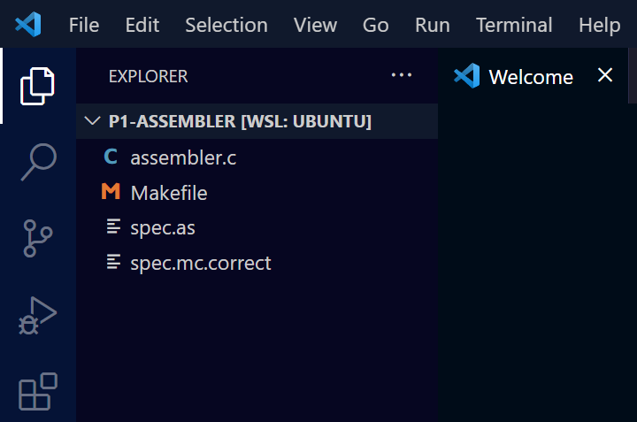
Let’s Look Around
Files
Search
Source Control (Git)
Debugging
Extensions

Slide 43
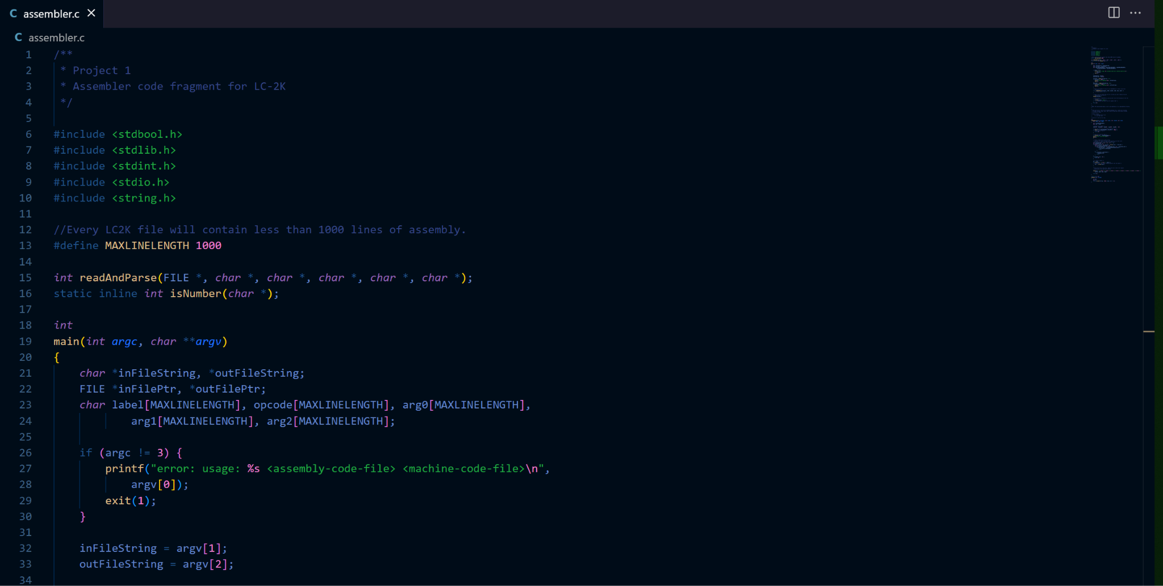
Let’s Look Around: Files

Slide 44
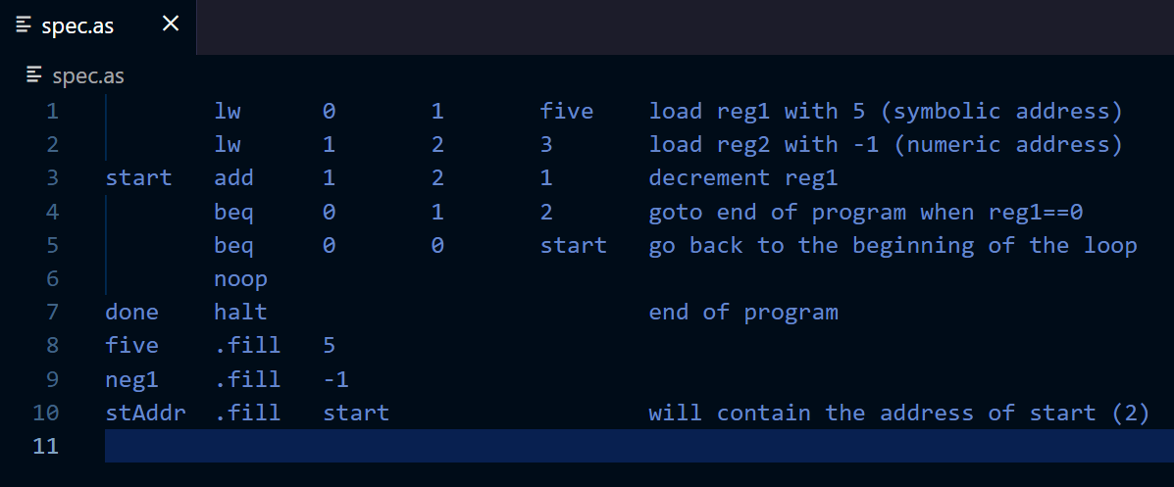
Let’s Look Around: Files
Hmm, this doesn’t look very nice…

Slide 45
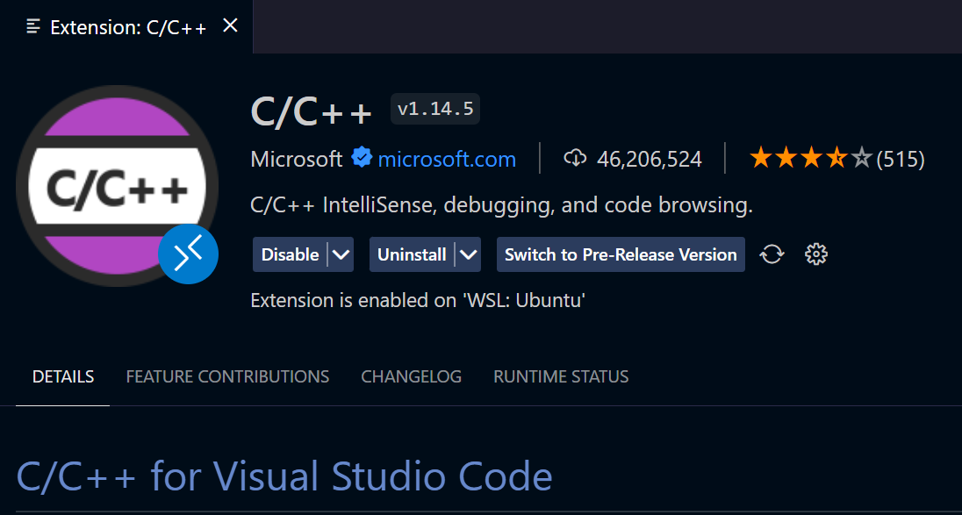
Let’s Look Around: Extensions
Top Recommendation: C/C++

Slide 46
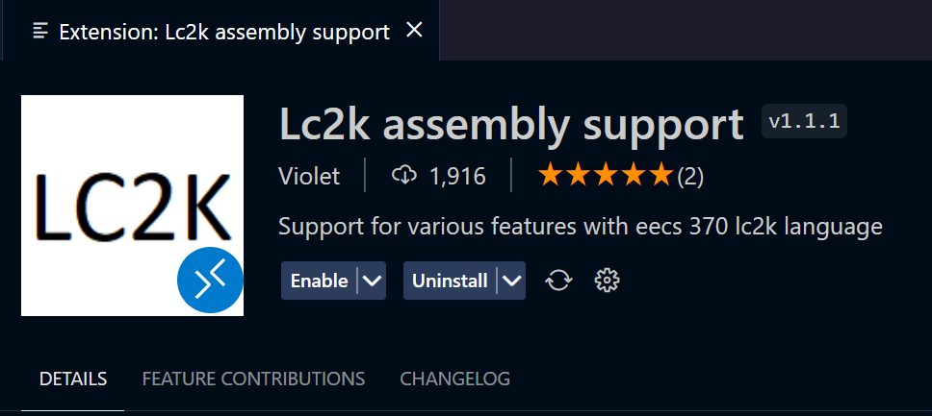
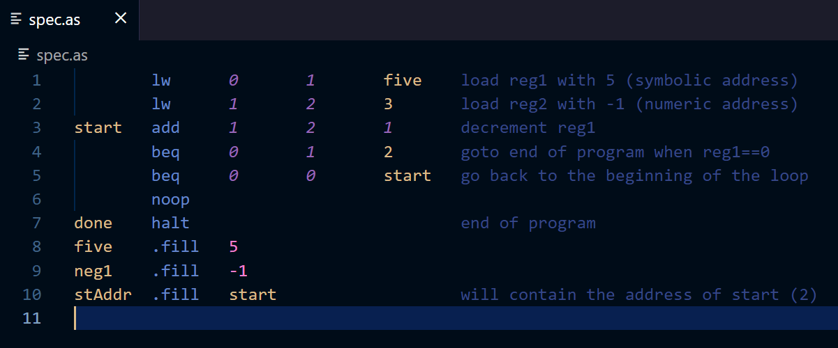
Let’s Look Around: Extensions
Next Recommendation: Lc2k (unofficial)
Now assembly code looks like this:

Slide 47
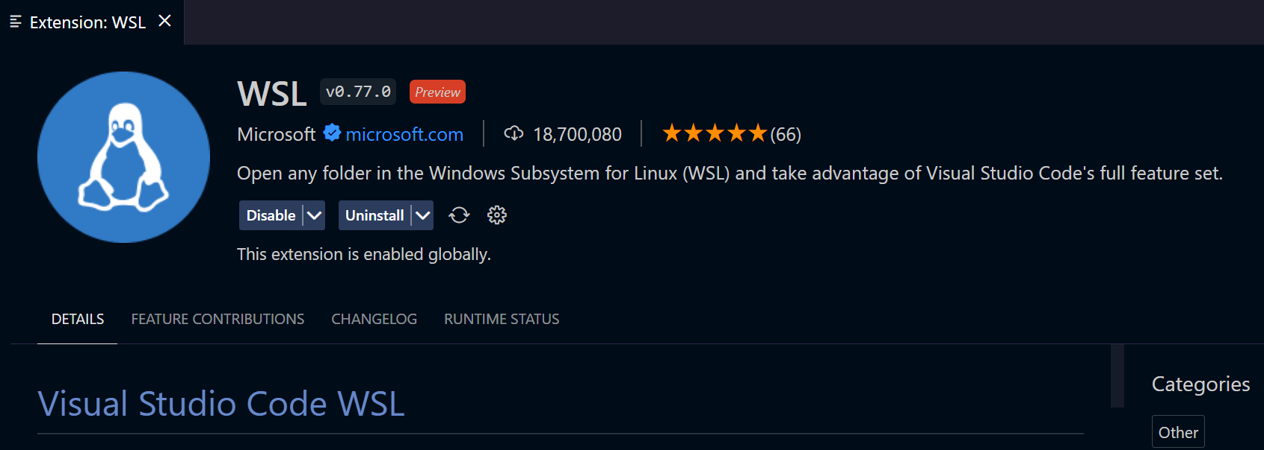
Let’s Look Around: Extensions
If on WSL:

Slide 48
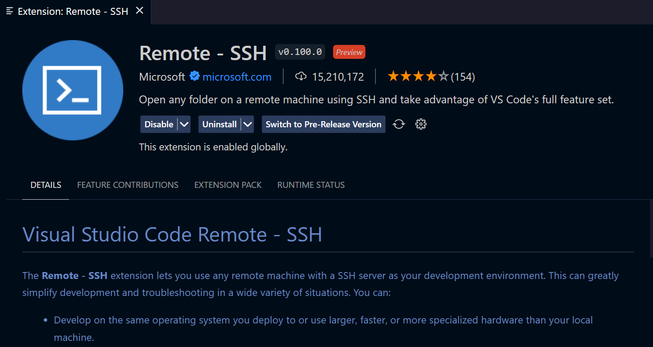
Let’s Look Around: Extensions
If you want to use CAEN without VNC: This is my primary method.

Slide 49
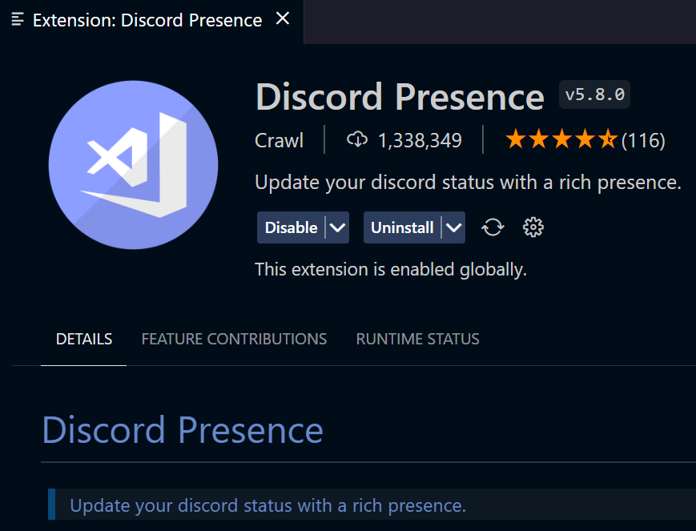
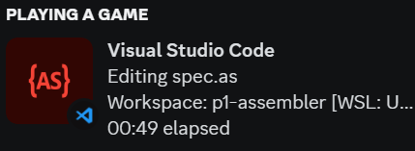
Let’s Look Around: Extensions
For fun: flex in discord

Slide 50
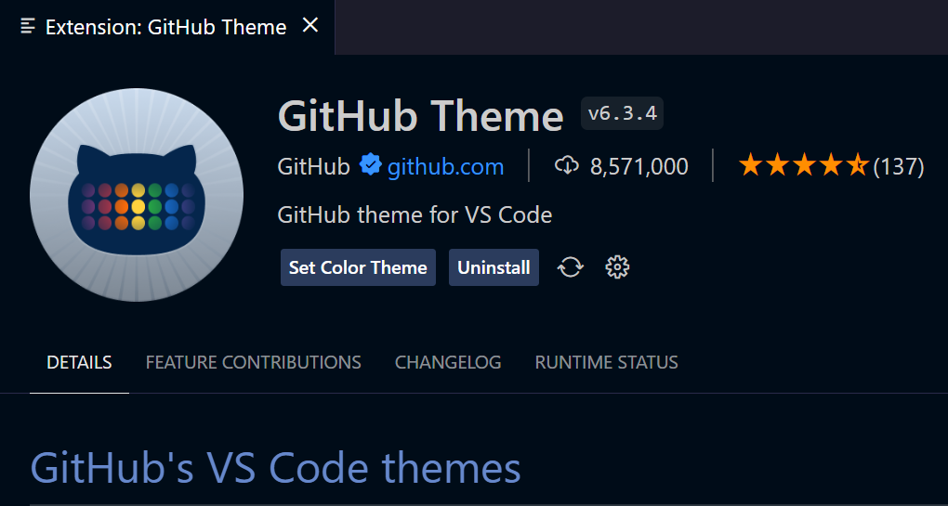
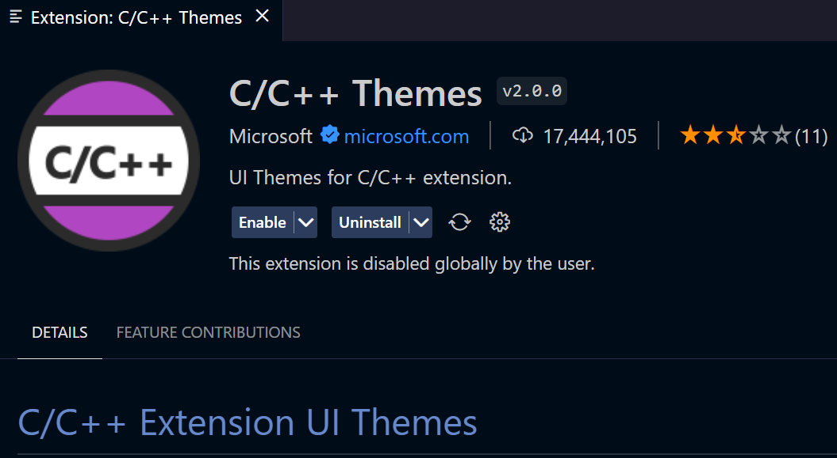
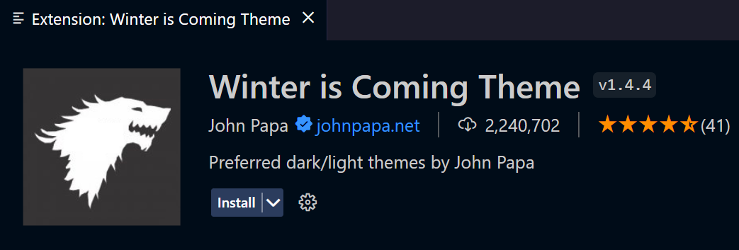
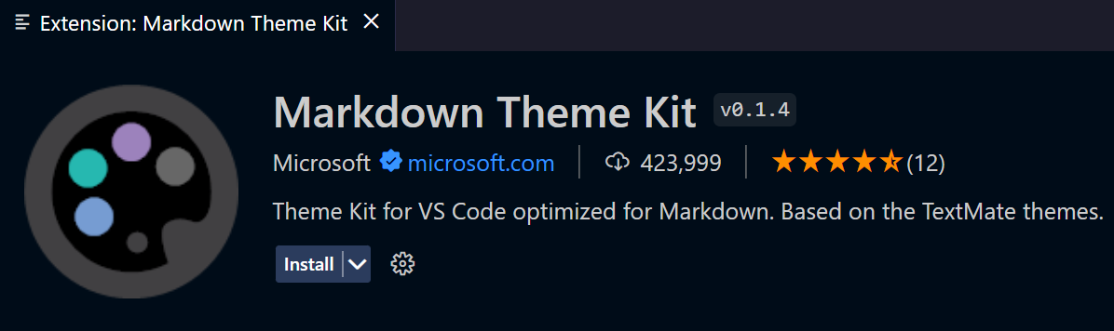
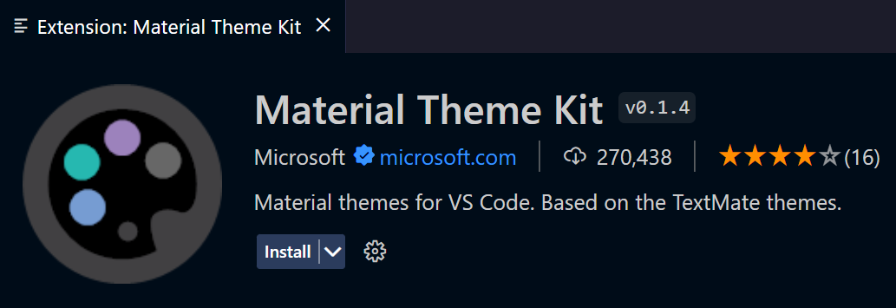
Let’s Look Around: Extensions
Themes! This is VITAL
There are a bunch: official + unofficial

Slide 51
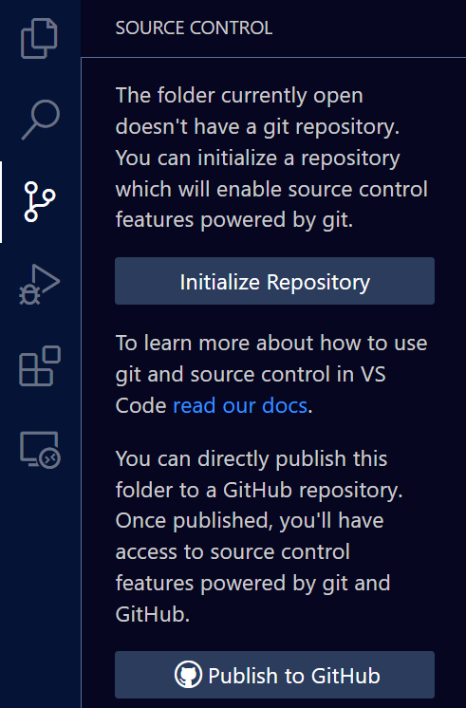
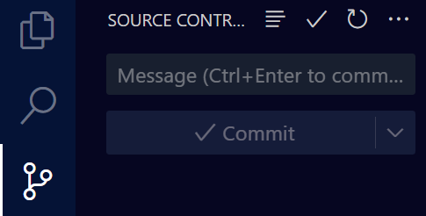
Let’s Look Around: Git
I HIGHLY HIGHLY recommend using Git, particularly on GitHub.
Why? Recover past versions. Easiest way to copy files to CAEN.
Follow: eecs280staff.github.io/tutorials/setup_git
After set up, there’s a nice gui. No cmd line needed

Slide 52
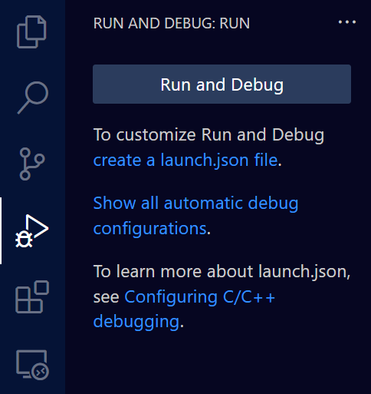
Let’s Look Around: Debugging
This part gets tricky. We need a launch.json file to debug in VSCode. And the automatic configs won’t work. :(
You can use my configs on the next few slides.

Slide 53
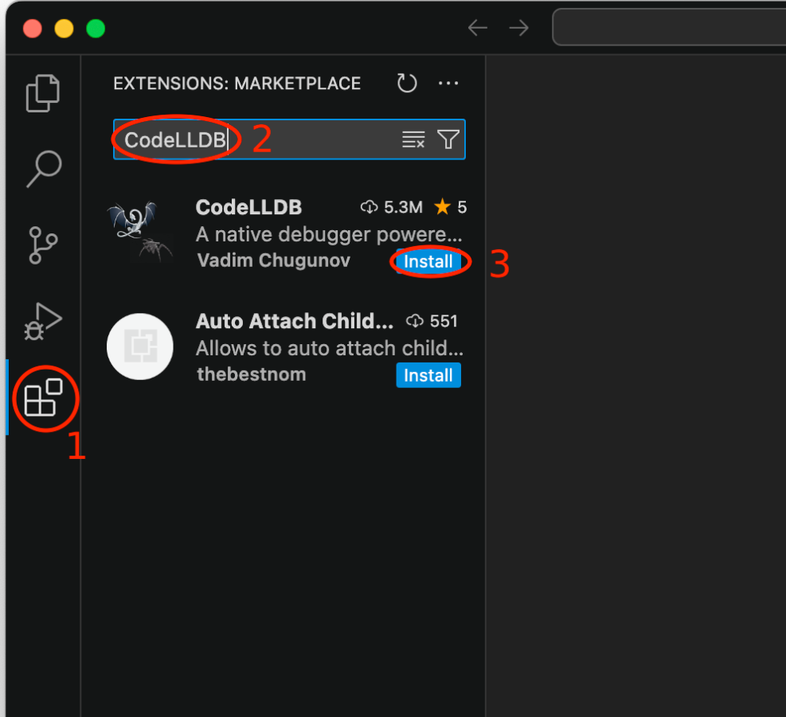
launch.json for macOS
Make sure to have the CodeLLDB extension installed on VSCode!
{
"version": "0.2.0",
"configurations": [
{
"type": "lldb",
"request": "launch",
"name": "Project 1a",
"program": "${workspaceFolder}/assembler",
"args": ["spec.as", "spec.mc"],
"cwd": "${workspaceFolder}",
"preLaunchTask": "C/C++: make assembler",
"preRunCommands": ["breakpoint set --name main"]
// ^ adds a breakpoint at the beginning of main
}
]
}

Slide 54
launch.json for Linux (WSL at least)
{
"version": "0.2.0",
"configurations": [
{
"name": "Project 1a",
"type": "cppdbg",
"request": "launch",
"program": "${workspaceFolder}/assembler",
"args": ["spec.as", "spec.mc"],
"stopAtEntry": true,
"cwd": "${workspaceFolder}",
"environment": [],
"externalConsole": false,
"MIMode": "gdb",
"miDebuggerPath": "/usr/bin/gdb",
"setupCommands": [{
"description": "Enable pretty-printing for gdb",
"text": "-enable-pretty-printing",
"ignoreFailures": true
}],
"preLaunchTask": "C/C++: make assembler"
}
]
}

Slide 55
tasks.json
{
"tasks": [{
"type": "cppbuild",
"label": "C/C++: make assembler",
"command": "/usr/bin/make",
"args": ["assembler"],
"options": {
"cwd": "${workspaceFolder}"
},
"problemMatcher": ["$gcc"],
"group": {
"kind": "build",
"isDefault": true
},
"detail": "Task generated by Debugger."
}],
"version": "2.0.0"
}

Slide 56
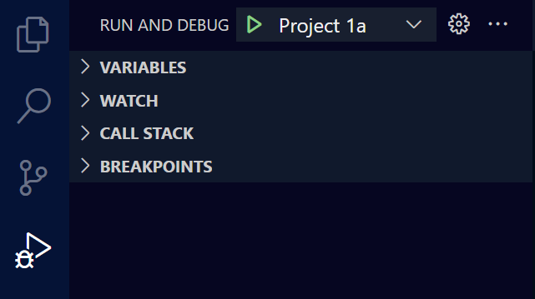
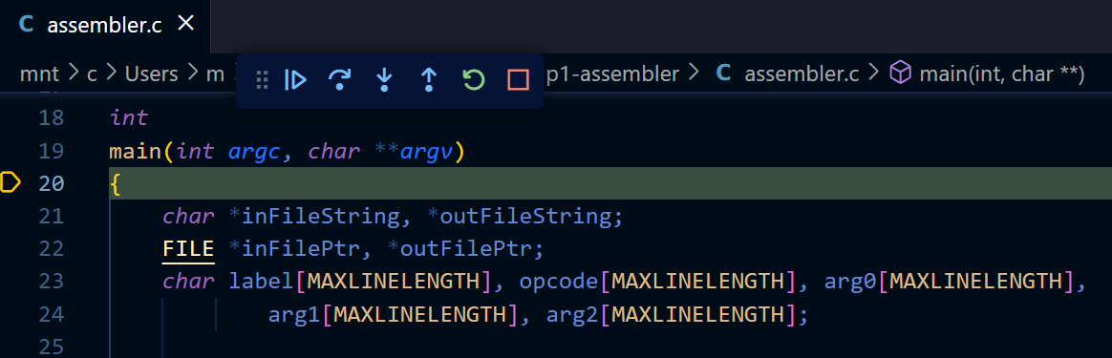
Let’s Look Around: Debugging
Now we can debug! Click the play button to start.
You should see something like this:

Slide 57
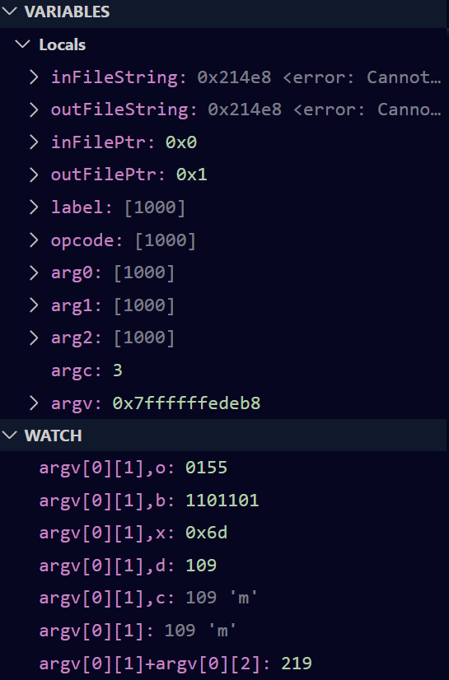
Let’s Look Around: Debugging
Expand the variables and watch panes:
Pro tip: you can type the name of a variable or expression in the watch pane if it doesn’t appear in “variables.”
You can also change the format on windows: see this for all specifiers. hex(expr) works on mac

Slide 58
EECS 370
Lab 1: Binary & C

